Slide 1
Learning Module I: Developmental Milestones and Recognizing Delays

Slide 2
Learning Objectives
Become familiar with four primary domains of development
Understand developmental milestones for children from birth to age 5
Identify “red flags”, or delays to watch for in children who are not meeting developmental milestones

Slide 3
This Presentation
4 main areas of development are broken down by age groups
Developmental milestones are presented in each development area
Red flags, or delays to watch for, are then presented
Steps to take if delays are recognized are included at conclusion of presentation

Slide 4
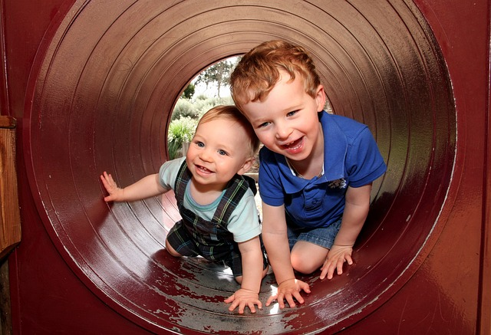
Development Milestones
Functional skills or age-specific tasks that most children can do by a certain age
Children reach milestones in how they play, learn, speak, behave, and move
A milestone is met when a child is able to perform a task without assistance

Slide 5
Developmental Domains
Development occurs in four main areas, or developmental domains in children:
Social/Emotional
Language/Communication
Cognitive
Movement/Physical Development

Slide 6
Social/Emotional
Loving relationships give young children a sense of comfort, safety, confidence, and encouragement
They teach young children how to form friendships, communicate emotions, and to deal with challenges
Strong, positive relationships also help children develop trust, empathy, compassion, and a sense of right and wrong

Slide 7
Language/ Communication
The capacity to communicate is the ability and desire to connect with others by exchanging ideas and feelings, both verbally and non-verbally
Most children learn to communicate to get a need met or to establish and maintain interaction with a loved adult

Slide 8
Cognitive
Development of the ability to think, understand, and reason
Cognitive abilities such as memory, information processing , and problem-solving emerge throughout childhood

Slide 9
Movement/Physical
Gross (or large) motor skills involve the larger muscles including the arms and legs. Actions requiring gross motor skills include walking, running, balance and coordination
Fine (or small) motor skills involve the smaller muscles in the fingers, toes, eyes and other areas. Actions that require fine motor skills are drawing, writing, throwing, waving and catching

Slide 10
Birth-Five Years
What does typical development look like?
When should certain developmental milestones be met?
What delays should be watched for?

Slide 11
Red Flags
Titled “Delays to Watch For” throughout presentation
Behaviors or delays that signal a possible problem with development and suggest that an evaluation should be performed

Slide 12
Two Months: Social Emotional
Social/Emotional
Begins to smile at people
Can briefly calm himself (i.e., bring hands to mouth, suck on hand)
Tries to look at parent

Slide 13
Two Months: Language/Communication
Coos, makes gurgling sounds
Turns head towards sounds

Slide 14
Two Months: Cognitive
Pays attention to faces
Begins to follow things with eyes and recognize people at a distance
Begins to act bored if activity doesn’t change

Slide 15
Two Months: Movement/Physical
Can hold head up and begins to push up when lying on tummy
Makes smooth movements with arms and legs

Slide 16
Delays to Watch For at Two Months
Doesn’t respond to loud sounds
Doesn’t watch things as they move
Doesn’t smile at people
Doesn’t bring hands to mouth
Can’t hold head up when on tummy
Typical and atypical development at two months

Slide 17
Four Months: Social Emotional
Smiles spontaneously, especially at people
Likes to play with people and might cry when playing stops
Copies some movements and facial expressions

Slide 18
Four Months: Language/Communication
Begins to babble
Babbles with expression and copies sounds he hears
Cries in different ways to show hunger, pain, or being tired

Slide 19
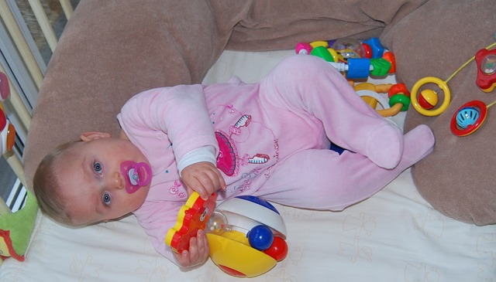
Four Months: Cognitive
Lets you know if she is happy or sad
Responds to affection
Reaches for toy with one hand
Uses hands and eyes together, such as seeing a toy and reaching for it
Follows moving things with eyes from side to side
Watches faces closely
Recognizes familiar people and things at a distance

Slide 20
Four Months: Movement/Physical Development
Holds head steady, unsupported
Pushes down on legs when feet are on a hard surface
May be able to roll over from tummy to back
Can hold a toy and shake it and swing at dangling toys
Brings hands to mouth
When lying on stomach, pushes up to elbows

Slide 21
Delays to Watch For at Four Months
Doesn’t watch things as they move
Doesn’t smile at people
Can’t hold head steady
Doesn’t coo or make sounds
Doesn’t bring things to mouth
Doesn’t push down with legs when feet are placed on a hard surface
Has trouble moving one or both eyes in all directions
Typical and atypical development at four months

Slide 22
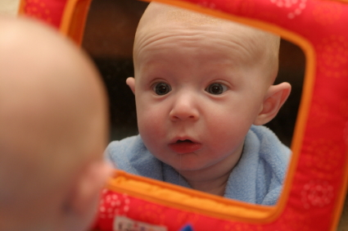
Six Months: Social Emotional
Social/Emotional
Knows familiar faces and strangers
Likes to play with others, especially parents
Responds to other people’s emotions and often seems happy
Likes to look at self in mirror

Slide 23
Six Months: Language/ Communication
Responds to sounds by making sounds
Strings vowels together when babbling and likes making sounds
Responds to own name
Makes sounds to show joy and displeasure
Begins to say consonant sounds

Slide 24
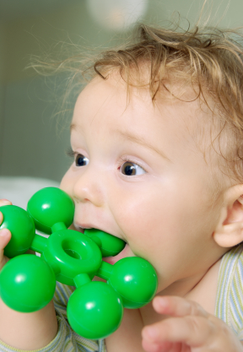
Six Months: Cognitive
Looks around at things nearby
Brings things to mouth
Shows curiosity about things and tries to get things that are out of reach
Begins to pass things from one
hand to the other

Slide 25
Six Months: Movement/Physical Development
Movement/Physical Development
Rolls over in both directions
Begins to sit without support
When standing, supports weight on legs and might bounce
Rocks back and forth, sometimes
crawling before moving

Slide 26
Delays to Watch For at Six Months
Doesn’t try to get things that are in reach
Shows no affection for caregivers
Doesn’t respond to sounds around him
Has difficulty getting things to mouth
Doesn’t make vowel sounds (“ah”, “eh”, “ee”, “oo”)
Doesn’t roll over in either direction
Doesn’t laugh or make squealing sounds
Seems very stiff, with tight muscles
Seems very floppy, like a rag doll
Typical and atypical development at 6 months

Slide 27
Nine Months: Social/Emotional
May be afraid of strangers
May be clingy with familiar adults
Has favorite toys
Snapshot of typical nine month development

Slide 28
Nine Months: Language/Communication
Understands “no”
Makes a lot of different sounds like “mamama” and “bababa”
Copies sounds and gestures of others
Uses fingers to point at things

Slide 29
Nine Months: Cognitive
Watches the path of something as it falls
Looks for things he sees you hide
Plays peek-a-boo
Puts things in her mouth
Moves things smoothly from one hand to another
Picks things like cereal up between thumb and index finger

Slide 30
Nine Months: Movement/Physical Development
Movement/Physical Development
Stands, holding on
Can get into sitting position
Sits without support
Pulls to stand
Crawls

Slide 31
Delays to Watch For at Nine Months
Doesn’t bear weight on legs with support
Doesn’t sit with help
Doesn’t babble (“mama”, “baba”, “dada”)
Doesn’t play any games involving back and forth play
Doesn’t respond to own name
Doesn’t seem to recognize familiar people
Doesn’t look where you point
Doesn’t transfer toys from one hand to the other
Early signs of autism in 10 month-old

Slide 32
One Year: Social/Emotional
Social/Emotional
Shy or nervous with strangers
Cries when parent leaves
Has favorite things and people
Shows fear in some situations
Hands you a book when they want to hear a story
Puts out arm or leg to help with dressing
Plays games such as “peek-a-boo” and “patty cake

Slide 33
One Year: Language/ Communication
Responds to simple spoken requests
Uses simple gestures like shaking head “no”
Makes sounds with changes in tone
Repeats sounds or actions to get attention
Says “mama” and “dada” and exclamations like “uh oh!”
Tries to say words you say
Copies gestures

Slide 34
One Year: Cognitive
Explores in different ways: shaking, banging, throwing
Finds hidden things easily
Looks at the right picture or thing when it’s named
Starts to use things correctly (i.e., brush, cup)
Bangs two things together
Puts things in a container, takes things out of container
Lets things go without help
Pokes with index finger
Follows simple directions
Typical one year development

Slide 35
One Year: Movement/Physical Development
Gets to a sitting position without help
Pulls up to stand, walks holding on to furniture
May take a few steps without holding on
May stand alone

Slide 36
Delays to Watch For at One Year
Can’t stand when supported
Doesn’t search for things that she sees you hide
Doesn’t say single words like “mama” or “dada”
Doesn’t learn gestures like waving or shaking head
Doesn’t point to things
Loses skills he once had

Slide 37
Eighteen Months: Social/Emotional
Social/Emotional
Likes to hand things to others as play
May have temper tantrums
May be afraid of strangers
Shows affection to familiar people
Plays simple pretend, such as feeding a doll
May cling to caregivers in new situations
Points to show others something interesting
Explores alone but with parent close by

Slide 38
Eighteen Months: Language/Communication
Says several single words
Says and shakes head “no”
Points to show someone he wants something

Slide 39
Eighteen Months: Cognitive
Knows what ordinary things are for (i.e., telephone, brush, spoon)
Points to get attention of others
Shows interest in a doll or stuffed animal by pretending to feed
Scribbles on his own
Can follow 1-step verbal commands without any gestures (i.e., follows command to sit down)

Slide 40
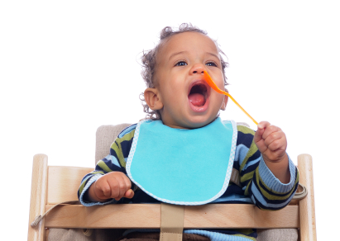
Eighteen Months: Movement/Physical Development
Walks alone
May walk up steps and run
Pulls toys while walking
Drinks from a cup
Eats with a spoon

Slide 41
Delays to Watch For at Eighteen Months
Doesn’t point to show things to others
Can’t walk
Doesn’t know what familiar things are for
Doesn’t copy others
Doesn’t gain new words
Doesn’t have at least 6 words
Doesn’t notice or mind when a caregiver leaves or returns
Loses skills he once had

Slide 42
Two Years: Social/Emotional
Copies others, especially adults and older children
Gets excited when with other children
Shows more independence
Shows defiant behavior
Plays mainly beside other children (parallel play), but begins to show socialization

Slide 43
Two Years: Language/ Communication
Points to things or pictures when they are named
Knows names of familiar people and body parts
Says sentences with 2-4 words
Follows simple instructions
Repeats words overheard in conversation
Points to things in a book

Slide 44
Two Years: Cognitive
Finds things, even when hidden
Begins to sort shapes and colors
Completes sentences and rhymes in familiar books
Plays simple make-believe games
Builds towers of 4 or more blocks
Might use one hand more than the other
Follows two-step instructions such as “pick up your shoes and put them in the closet”
Names items in a picture book

Slide 45
Two Years: Movement/Physical Development
Stands on tiptoes
Kicks a ball
Begins to run
Climbs onto and down from furniture without help
Walks up and down stairs holding on
Throws ball overhand
Makes or copies straight lines and circles

Slide 46
Delays to Watch For at Two Years
Doesn’t use 2-word phrases (i.e., “drink milk”)
Doesn’t know what to do with common things like a brush, phone, fork, or spoon
Doesn’t copy actions and words
Doesn’t follow simple instructions
Doesn’t walk steadily
Loses skills she once had
Signs of developmental delay at two years

Slide 47
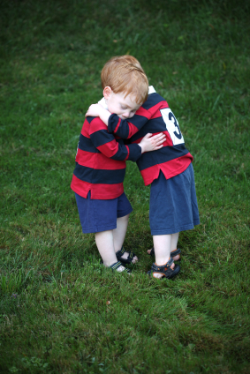
Three Years: Social/Emotional
Copies adults and friends
Shows affection for friends
Takes turns in games
Shows concern for crying friend
Understands idea of “mine”, “his”, and/or “hers”
Shows wide range of emotions
Separates easily from mom and dad
May get upset with changes in routine
Dresses and undresses self

Slide 48
Three Years: Language/Communication
Follows 2-3 step instructions
Can name most familiar things
Understands words like “in”, “on”, and “under”
Says first name, age, and sex
Names a friend
Says words like “I”, “me”, “we”, and “you” and names some objects
Talks well enough for strangers to understand
Carries on conversation using 2 to 3 sentences
Language sample of a three year old

Slide 49
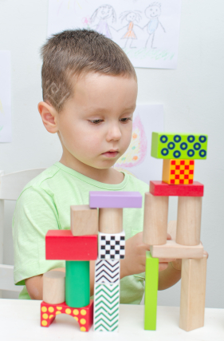
Three Years: Cognitive
Can work toys with buttons, levers, and moving parts
Plays make believe with dolls, animals, and people
Does puzzles with 3 or 4 pieces
Understands what “two” means
Copies a circle with pencil or crayon
Turns book pages one at a time
Builds towers of more than 6 blocks

Slide 50
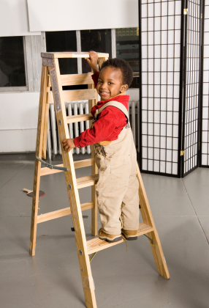
Three Years: Movement/Physical Development
Climbs well
Runs easily
Pedals a tricycle
Walks up and down stairs,
one foot on each step
Screws and unscrews jar lids
or turns door handle

Slide 51
Delays to Watch For at Three Years
Falls down often or has trouble with stairs
Drools or has very unclear speech
Can’t work simple toys such as peg boards, simple puzzles, turning handles
Doesn’t speak in sentences
Doesn’t understand simple instructions
Doesn’t play pretend or make-believe
Doesn’t want to play with other children or with toys
Doesn’t make eye contact
Loses skills he once had
Signs of developmental delay at three years

Slide 52
Four Years: Social/Emotional
Enjoys doing new things
Plays “mom” and “dad”
Is more creative with make-believe play
Would rather play with other children than by himself
Cooperates with other children
Often can’t tell what’s real and what’s make believe
Talks about what she likes and what she is interested in

Slide 53
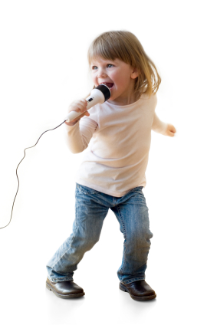
Four Years: Language/ Communication
Knows some basic rules of grammar, like correctly using “he” or “she”
Sings a song or says a poem from memory
Tells stories
Can say first and last name

Slide 54
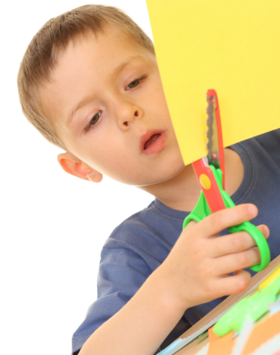
Four Years: Cognitive
Names some colors and numbers
Understands idea of counting
Starts to understand time
Remembers parts of a story
Understands idea of “same” and “different”
Draws a person with 2 to 4 body parts
Uses scissors
Starts to copy some capital letters
Plays board or card games
Tells you what he thinks is going
to happen next in a book

Slide 55
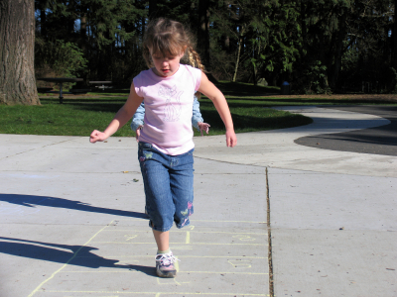
Four Years: Movement/Physical Development
Hops and stands on one foot up to 2 seconds
Catches a bounced ball most of the time
Pours, cuts, and mashes own food

Slide 56
Delays to Watch For at Four Years
Can’t jump in place
Has trouble scribbling
Shows no interest in interactive games or make-believe
Ignores other children or doesn’t respond to people outside the family
Resists dressing, sleeping, and using the toilet
Can’t retell a favorite story
Doesn’t follow 3-part commands
Doesn’t understand “same” and “different”
Doesn’t use “me” and “you” correctly
Speaks unclearly
Loses skills he once had
Signs of developmental delay at age 4

Slide 57
Five Years: Social/Emotional
Wants to please friends
Wants to be like friends
More likely to agree with rules
Likes to sing, dance, and act
Shows concern and sympathy for others
Is aware of gender
Can tell what’s real and what’s make-believe
Shows more independence
Is sometimes demanding and sometimes very cooperative
Developmental milestones at five years

Slide 58
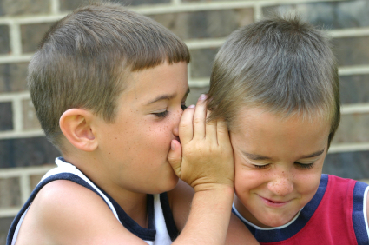
Five Years: Language/ Communication
Speaks very clearly
Tells a simple story using full sentences
Uses future tense
Says name and address

Slide 59
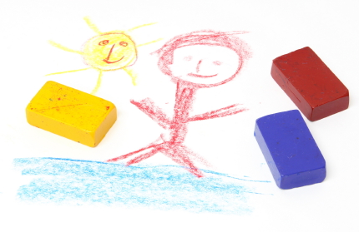
Five Years: Cognitive
Counts 10 or more things
Can draw a person with at least 6 body parts
Can print some letters or numbers
Copies a triangle and other geometric shapes
Knows about things used everyday, like money and food

Slide 60
Five Years: Movement/Physical Development
Movement/Physical Development
Stands on one foot for 10 seconds or longer
Hops; may be able to skip
Can do a somersault
Uses a fork and spoon and
sometimes a table knife
Can use the toilet on her own
Swings and climbs

Slide 61
Delays to Watch For at Five Years
Doesn’t show a wide range of emotions
Shows extreme behavior (fearful, aggressive, shy, or sad)
Unusually withdrawn and not active
Is easily distracted, has trouble focusing on one activity for more than 5 minutes
Doesn’t respond to people or only responds superficially
Doesn’t play a variety of games and activities
Can’t give first and last name

Slide 62
Delays, continued
Doesn’t use plurals or past tense properly
Doesn’t talk about daily activities or experiences
Doesn’t draw pictures
Can’t brush teeth, wash and dry hands, or get undressed without help
Loses skills he once had
Developmental Delays at five years

Slide 63
What To Do If You Recognize Delays
Call United Way #211
Refer to pediatrician
Refer to Allegheny Intermediate Unit (412)-394-5700
Refer to Child Development Unit (412)-692-5560

Slide 64
Content source: Division of Birth Defects, National Center on Birth Defects and Developmental Disabilities, Centers for Disease Control and Prevention
Presentation developed by Carmen Jamis, M.S. and Alyssa Newberry, M.Ed. representing the LEND Center of Pittsburgh, University of Pittsburgh, and Children’s Hospital of Pittsburgh

